Slide 1
COMESA DIGITAL RETAIL PAYMENTS PLATFORM (DRPP) UPDATE
KEMPINSKI HOTEL
ACCRA-GHANA
14th April 2025
Notes:
Jedidah Welcome

Slide 2
Outline
1
Outcomes and Journey to Soft Launch
2
Soft Launch Configuration
3
Success Factors
4
Clearance and Settlement Primer
5
Conclusion
Notes:
[JN]

Slide 3
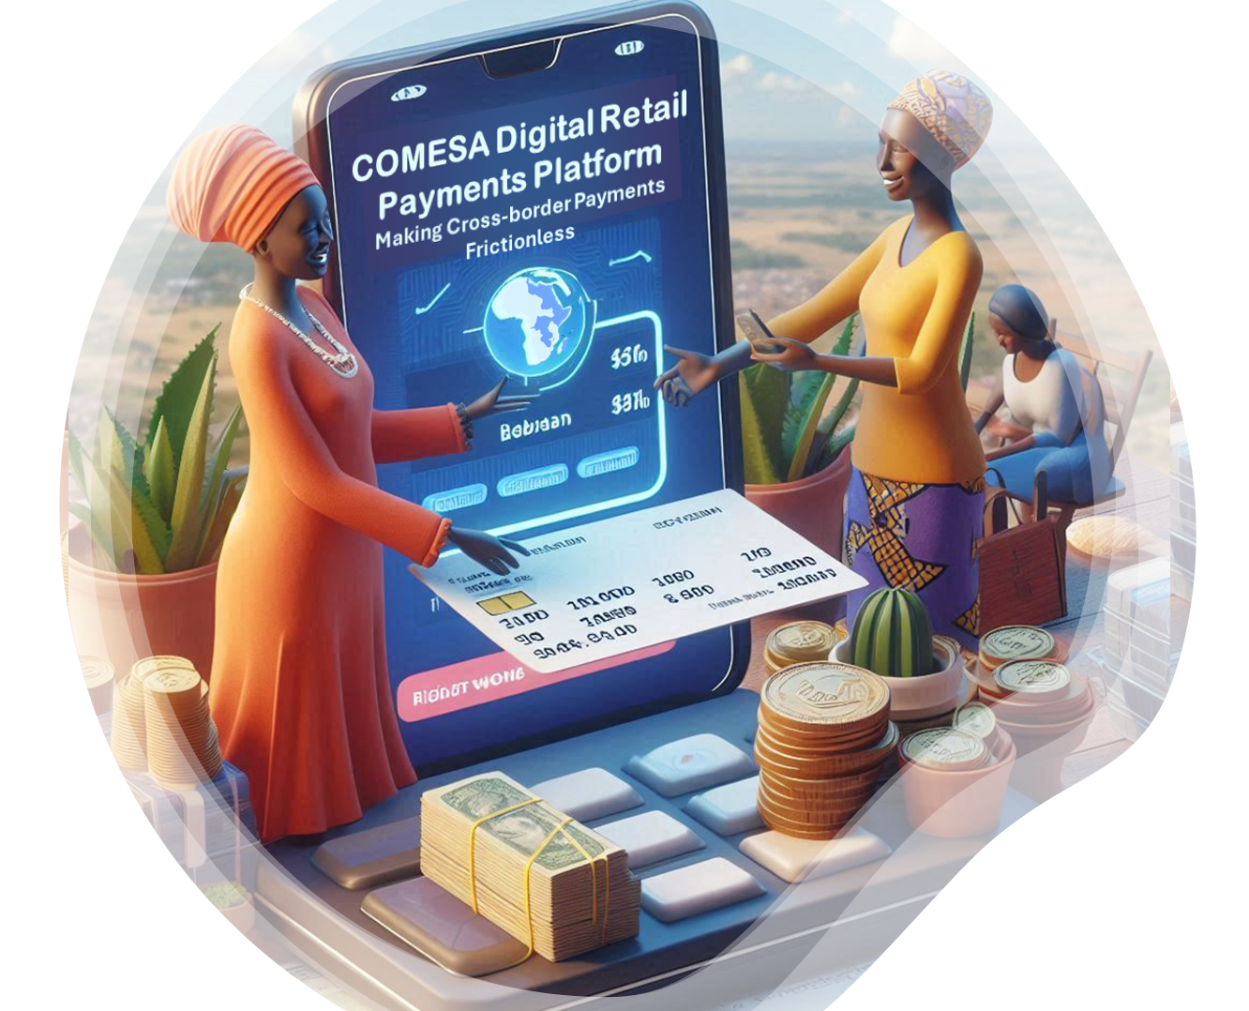






Regional Outcomes
Equitable inclusion of citizens and all classes of traders
Participation of MSMEs in formal Regional Trade
Increased Volumes of cross-border Transactions
Scaled access for Forex Providers
Increased visibility of African Products within the Regional Markets
Notes:
[JP]
Program Vision / Mission Objectives [JP]
The DRPP aims to improve interregional trade and financial inclusion by the formation of regional payments rails that provides for real-time clearance of payments, central bank based settlement and cross-currency services by commercial players (aka Forex Service Providers, FPSs) which will have the benefit of scaled access to all participating jurisdictions as the they authorised to, meaning that corridors which would previously have been prohibitively costly to enter can now be services without the infrastructure costs associated with establishing a new market.

Slide 4
Journey - Phased Approach
Phase | Title | Summary
1 | Fake Money on Fake Rails | DFSPs connect to simulated infrastructure using fake money to test system integration without risk.
2 | Fake Money on Real Rails | Testing continues on live rails, still using fake money, to assess system interaction with real infrastructure.
3 | Soft Launch: Friendly User Trials | Real transactions with a limited user group to validate compliance, performance, and security.
4 | Soft Launch: Closed User Group | Full DRPP deployment to a closed group for final testing and issue resolution.
5 | Commercial Availability | DRPP goes live; DFSPs operate at scale on a secure and compliant platform.
Notes:
[JP]
The DRPP rollout is designed around a structured, phased approach that carefully prepares DFSPs for full commercial participation.
This approach is intentional — it helps minimise risk, validate system performance, and ensure compliance with scheme rules and local regulations at every step.
We begin in simulated environments, using ‘fake money’ and controlled rails, to allow DFSPs to complete their integration safely and iteratively.
As the integration stabilises, we move into more realistic testing scenarios — introducing live infrastructure while still using test funds — before transitioning to friendly user trials and full production.
This progression gives Early Adopters the confidence to go live, knowing their systems have been thoroughly validated and supported through each phase.
It also ensures that by the time DFSPs enter commercial operations, they are technically sound, operationally ready, and aligned with the DRPP compliance model.

Slide 5



DRPP Soft Launch Configuration
$
FX Providers
DFSP
DRPP Administrative Boundary
DFSP
DFSP
Regional Hub
DFSP
Zambia
eNIIPS
Malawi eNIIPS
DFSP
DFSP
Payment Matrix per currency is distributed to jurisdictions
DFSP
DFSP
Merged Payment Matrix to Settlement Processor
Merged Payment Matrix to Settlement Processor
Zambia
DFSPs
Malawi
DFSPs
Domestic Settlement Provider
Domestic Settlement Provider
Participation Tools
Inter-Scheme Proxies
ISO 20022 for IIPS
Payment Manager
Notes:
WDC
The Soft Launch configuration of the DRPP Scheme will include an Early Adopter DFSP in Zambia and Malawi. During this phase the DRPP will host emulated National IIPS schemes on behalf of these jurisdictions, along with the Regional Hub.
This setup ensures that regulators maintain jurisdictional sovereignty while allowing local operators to explore the solution’s capabilities if they choose.
It's important to note that Foreign Exchange providers are only connected to the Regional Hub.
DFSPs connect exclusively to their respective Local Schemes and transact solely in local currency.

Slide 6



































Contributors and Early Adopters
Early Participants
Regulatory WG
Technical & Standards WG
Commercial WG
Notes:
[JP]
Strategic Participation: DFSPs and FX Providers contribute to refining scheme rules, operating guidelines, and SOPs.
Exclusive Support: DRPP program provides onboarding and participation support via local SI resources.
Phased Approach: Ensures secure, efficient, and scalable adoption.
Regulatory Alignment: Developed in collaboration with COMESA member states’ central banks and regulatory bodies.
Financial Inclusion: Strengthening interoperability and economic integration across the region.
Soft Launch Readiness: Early adopters gain first-mover advantages and insights into operational processes.
Early adopters have the unique opportunity to influence the development of scheme rules, operating guidelines, and standard procedures. Their participation ensures a tailored onboarding experience, access to dedicated support, and a first-mover advantage in leveraging DRPP’s interoperability and regional financial inclusion efforts. By engaging early, they help shape the future of cross-border digital payments while securing a strategic position in the evolving ecosystem.

Slide 7
Success Factors
1. Stakeholder Collaborations
6. Compelling
Value Proposition
2. Regulatory support and approvals from Central Banks
5. Rapid Go To Market
3. Eco system
4. Cross currency algorithm
Notes:
[ JN ]

Slide 8
Regulatory Support
The role of Central Banks in DRPP
Shepherding transformative change balancing inclusivity and economic stability
⇒ World leading regulatory reform
Regulatory Oversight and Compliance
Monetary Policy and Financial Stability
Clearing and Settlement Framework
Risk Management and Cybersecurity
Capacity Building and Stakeholder Engagement
Support for Innovation and Financial Inclusion
Notes:
[ JN / Patrick ]

Slide 9
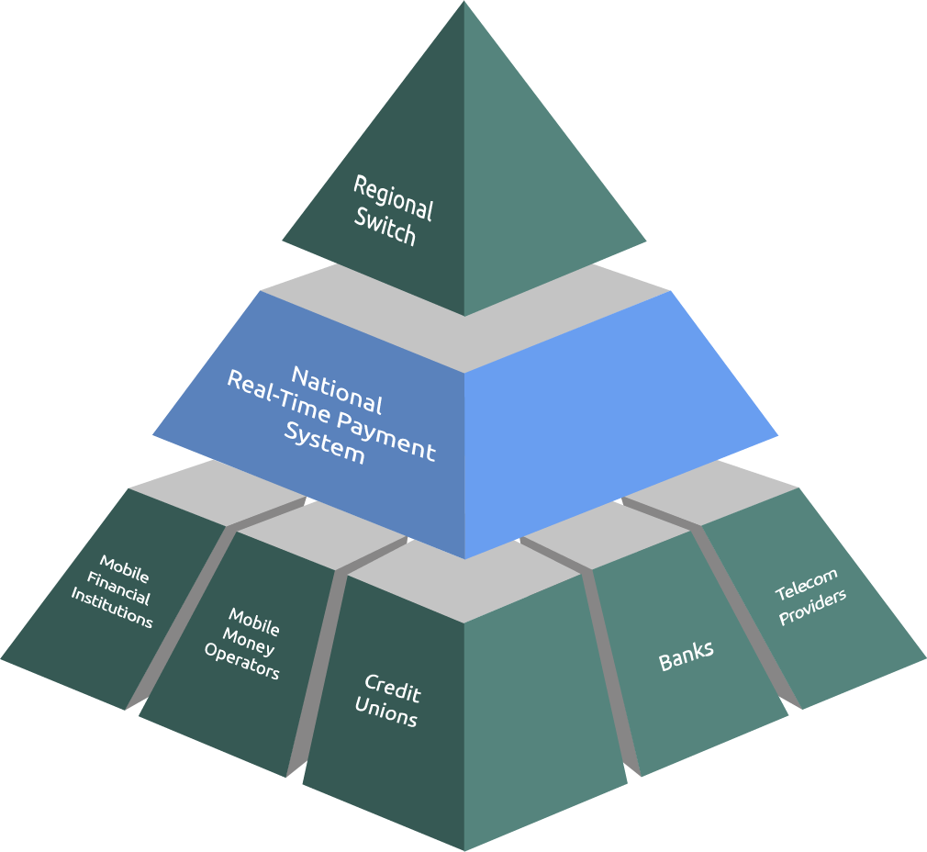
Ecosystem Collaboration
International, Regional and Local participants resulting in transformative Service
Novel solution for local currency algorithm
Early Adopters innovate on delivery
Interoperability
Government support
Training Institutions/Trainers for capacity building
DRPP enables end users Citizens and Merchants/Cross border Traders Associations
Regulator Enablers
World Bank
International Standards
COMESA Committee of
Governors of Central Banks
Implementing Enablers
DPG/I Foundations
COMESA Clearing House
Central Banks
DFSPs
Technology Partners
Hub Operators
System Integrators
Notes:
[ JP ]

Slide 10
Local Currency Algorithm
International remittances at scale with net settling in local currency, DRPP is an:
Inclusive and Instant Payment Solution (IIPS)
Pre-funded liquidity and liquidity management guarantees settlement in local currency
Orchestration of ISO 20022 for IIPS delivered with 3 phases
Discovery
Agreement
Transfer
⇒ Ensures that scalable solution, real-time decisions are binding, reducing failed transactions, and net settlement is covered by pre-funded liquidity
Where Foreign Exchange Providers (FXPs)
Have scaled market access through single connection to the regional hub
Can manage forex exposure by quoting rate per transaction,
so can adapt to market movements
Settlement is in the local jurisdiction in local currency,
FXP trade independently for destination currencies
⇒ Graceful limiting of exposure - either through liquidity caps or agreement phase and no settlement risk
Notes:
[ WDC -]
Local MW and ZM DFSPs only settle in local currency – no exposure to foreign currency and complexity of cross border settlement
So FXPs never have to commit to large windows at a fixed rate, and are guaranteed that source currency funds are available to cover purchase of destination currency
DFSPs and FXPs only need a single prefunding in each currency and the eNIIPS and Regional scheme ensure that the liquidity effeciency
Inclusive and Instant Payment Solution (IIPS)
Where pre-funded liquidity and liquidity management guarantees settlement
Orchestration of ISO20022 for IIPS delivered with 3 phase
Discovery allows for scaling of the user base
Upfront Agreement of Terms ensures near to zero failed transactions and disputes
Transfer
Orchestration ensures that real-time decisions are binding and covered by pre-funded liquidity
Foreign Exchange Providers (FXPs)
Connect to the regional hub giving [ with authorisation ] scaled access to any jurisdictions already connected or connected in the future
Can quote rate for each transaction they process, so can adapt to market movements
Settlement in local jurisdictions in local currency, FXP trade independently for destination currencies
Graceful limiting of exposure - either through liquidity caps or agreement phase

Slide 11

How an Instant DRPP Works End-to-End
ISO 20022 for IIPS
DRPP
MWK
ZMW
Emulated National
IIPS
Emulated National
IIPS
FSP
FSP
1
P
M
Foreign Exchange Provider
2
Foreign Exchange Provider
3
4
3rd Party Data Stream
Proxy
Proxy
Discovery Phase
Agreement Phase
Transfer Phase
Settlement Mngmt
Confirmation of payee accounts and currencies
Agreement of conversion Terms
4
Provision of liquidity cover
and clearance of funds
5
DRPP Net Settlement Request
1
2
3
Agreement of transfer Terms
6
National Merged Net Settlement Request
Notes:
WDC

Slide 12
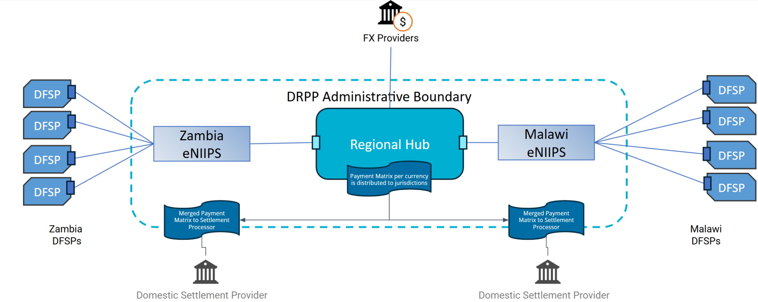
Rapid Go To Market
Existing Financial and Technical Support
eNIIPS deployment in Jurisdictions
Soft Launch to refine operational approaches
DFSPs given authorisation to Participate in DRPP
ISO 20022 for IIPS (Standards) robust for future interoperability
Regulatory Support
ISO 20022 for IIPS
Notes:
[JP ]

Slide 13
Value Proposition
Reduced risks ⇒ Greater efficiency ⇒ reduced Costs
Local currency net settlement
Instant and Inclusive Payments
Wide geographic reach because of integration of Mobile Network Operators
Security
Cost model which brings affordability
Notes:
JP

Slide 14

Proposed Cost Structure
Currency Conversion cost
Forex rate * Amount sent
Variable Cost = or
Amount to be received / Forex rate
The World Bank target is that the consumer (citizen or merchant) pays < 3% of the principle in costs
Through their DFSPs service channel (USSD/APP/Website) the Consumer sees the following break down:
Costs < 3% TARGET
DFSP Processing cost
Often tiered based on increased costs including liquidity and variable compliance.
Needs to cover standing charges for scheme participation and processing fee.
DRPP Processing cost
Fixed cost for all transactions since effort same to manage prefunded liquidity.
Total Cost to Consumer =
< $2
Increasing Transaction Value
> $2
A Variable Conversion Cost
DRPP Settlement Processing fees
Process as a net settlement for a number of transactions, these are small contribution to each transaction in terms of operating costs.
Typically, the DRPP will pay a maximum of one less the number of DFSPs per jurisdiction times the settlement fee at the national switch/RTGS.
+
A Tiered DFSP Processing Fee
Notes:
JP
Regulatory Support / Crytpo graphic lock helps reduce DFSP costs
…
Goal to reduce all three

Slide 15
Video Demos
Clearance and Settlement Primer
Notes:
[ WDC get right with feedback from Steve ]
Cross-Border Payment Flow Using COMESA DRPP
Imagine Horace in Malawi wants to send money in Malawian Kwacha (MWK) to Peter in Zambia, who banks in Zambian Kwacha (ZMW). Since both countries are part of the COMESA Digital Retail Payment Platform (DRPP), the process is seamless and instant.
Payment Initiation: Peter initiates a transfer from his Equity Bank account. If his account is in good standing, Equity forwards the request through Kenya’s local payment scheme.
Regional Processing: Since Otis is in Zambia, the request moves to the DRPP Regional Hub, which locates Otis’ bank, UBA, and confirms that his account is active.
Currency Exchange & Approval: The Regional Hub engages Foreign Exchange Providers (FXPs) to secure the required Zambian Kwacha (ZMW). The terms are presented to Peter, who accepts them, allowing Equity to reserve funds for the transaction.
Fund Clearance: The Regional Hub and Zambian local scheme ensure funds are available, enabling UBA to credit Otis’ account while expecting settlement from the FXP.
Confirmation & Settlement: Once the payment clears, UBA, Zambia’s local scheme, the DRPP, and Equity confirm the successful transfer to Peter.
This system ensures instant, secure, and compliant cross-border payments within COMESA, with central banks providing oversight but not financial backing for settlements.

Slide 16
DRPP Vision
Commercial availability
Onboarding of additional COMESA countries
Value Added Services
Innovation and Testing ground
Notes:
Cross-Border Payment Flow Using COMESA DRPP
Imagine Horace in Malawi wants to send money in Malawian Kwacha (MWK) to Peter in Zambia, who banks in Zambian Kwacha (ZMW). Since both countries are part of the COMESA Digital Retail Payment Platform (DRPP), the process is seamless and instant.
Payment Initiation: Peter initiates a transfer from his Equity Bank account. If his account is in good standing, Equity forwards the request through Kenya’s local payment scheme.
Regional Processing: Since Otis is in Zambia, the request moves to the DRPP Regional Hub, which locates Otis’ bank, UBA, and confirms that his account is active.
Currency Exchange & Approval: The Regional Hub engages Foreign Exchange Providers (FXPs) to secure the required Zambian Kwacha (ZMW). The terms are presented to Peter, who accepts them, allowing Equity to reserve funds for the transaction.
Fund Clearance: The Regional Hub and Zambian local scheme ensure funds are available, enabling UBA to credit Otis’ account while expecting settlement from the FXP.
Confirmation & Settlement: Once the payment clears, UBA, Zambia’s local scheme, the DRPP, and Equity confirm the successful transfer to Peter.
This system ensures instant, secure, and compliant cross-border payments within COMESA, with central banks providing oversight but not financial backing for settlements.

Slide 17



Slide 18
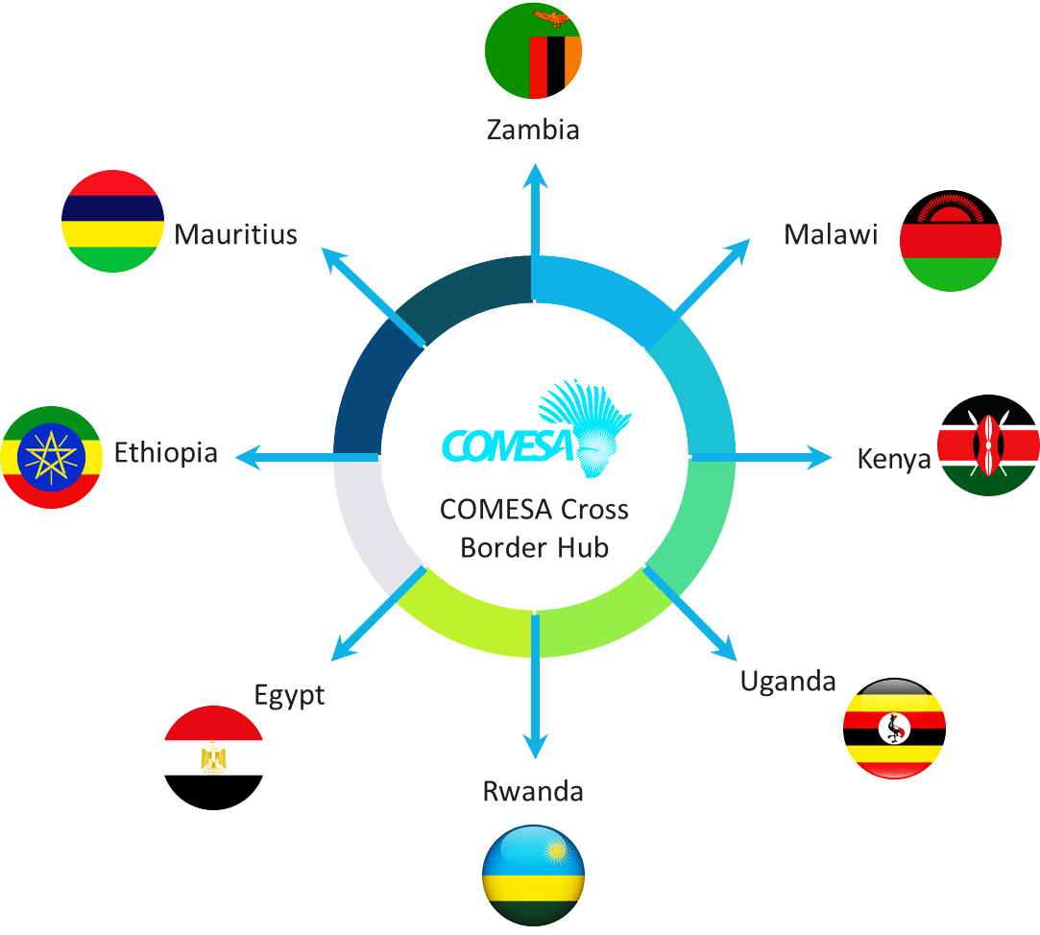
COMESA Region
Country |  | Currency | Symbol
1 | Republic of Burundi | Burundi franc | FBU
2 | Union of the Comoros | Comorian franc | KMF
3 | Democratic Republic of the Congo | Congolese franc | CDF
4 | Republic of Djibouti | Djibouti Franc | DJF
5 | Arab Republic of Egypt | Egyptian pound | EGP
6 | Kingdom of Eswatini | Lilangeni | SZL
7 | State of Eritrea | Nakfa | ERN
8 | Federal Democratic Republic of Ethiopia | Ethiopian Birr | ETB
9 | Republic of Kenya | Kenyan shilling | KES
10 | Libya | Dinar | LYD
11 | Republic of Madagascar | Malagasy Ariary | MGA
12 | Republic of Malawi | Malawian Kwacha | MWK
13 | Republic of Mauritius | Mauritian rupee | MUR
14 | Republic of Rwanda | Rwandan franc | RWF
15 | Republic of Seychelles | Seychellois rupee | SCR
16 | Federal Republic of Somalia | Somali shilling | SOS
17 | Republic of The Sudan | Sudanese pound | (SDG,SDD)
18 | Republic of Tunisia | Tunisian dinar | TND
19 | Republic of Uganda | Ugandan shilling | UGX
20 | Republic of Zambia | Zambian Kwacha | ZMW
21 | Republic of Zimbabwe | Zimbabwe Dollars | ZWD
Pilot Roll out

Slide 19


Use Cases and Business Operations
Initial Use Cases
Planned Use Cases
Person-to-Person (P2P) Payments: Facilitates instant remittances between individuals across Member States.
Person-to-Business (P2B) Payments: Enables quick and secure payments for merchants, encouraging regional trade.
QR-code-enabled merchant payments for small businesses.
Multi-currency settlements for traders and businesses.
Enhanced fraud and transaction monitoring systems.

Slide 20
Citizen Pays. The target is that the consumer (citizen or merchant) pays < 3% of the principle in costs
3.0% | Cost Cap as % of Principle Value (P.V.)
2.5 | DRPP Processing Fee in USD cents
0.50% | DFSP Processing Costs over and above DRPP costs
1% | Currency Conversion Cost
Principle Value (P.V.) [USD] | Cost Cap as % of P.V. [USD] | DRPP Processing Cost [USD] | DFSP Processing Costs [USD] | DFSP total cost [USD] | Currency Conversion Cost [USD] | Costs to Execute [USD] | Cost to Execute as % of P.V. [%] | Marginal Profit Opportunity [USD]
1 | 0.0291 | 0.0250 | 0.0050 | 0.0300 | 0.0100 | 0.0400 | 4.0% | 0.00
2 | 0.0583 | 0.0250 | 0.0100 | 0.0350 | 0.0200 | 0.0600 | 3.0% | 0.00
3 | 0.0874 | 0.0250 | 0.0150 | 0.0400 | 0.0300 | 0.0700 | 2.3% | 0.02
5 | 0.1456 | 0.0250 | 0.0250 | 0.0500 | 0.0500 | 0.1000 | 2.0% | 0.05
10 | 0.2913 | 0.0250 | 0.0500 | 0.0750 | 0.1000 | 0.1800 | 1.8% | 0.11
12 | 0.3495 | 0.0250 | 0.0600 | 0.0850 | 0.1200 | 0.2100 | 1.8% | 0.14
13 | 0.3786 | 0.0250 | 0.0650 | 0.0900 | 0.1300 | 0.2200 | 1.7% | 0.16
15 | 0.4369 | 0.0250 | 0.0750 | 0.1000 | 0.1500 | 0.2500 | 1.7% | 0.19
20 | 0.5825 | 0.0250 | 0.1000 | 0.1250 | 0.2000 | 0.3300 | 1.7% | 0.25
30 | 0.8738 | 0.0250 | 0.1500 | 0.1750 | 0.3000 | 0.4800 | 1.6% | 0.39
50 | 1.4563 | 0.0250 | 0.2500 | 0.2750 | 0.5000 | 0.7800 | 1.6% | 0.68
100 | 2.9126 | 0.0250 | 0.5000 | 0.5250 | 1.0000 | 1.5300 | 1.5% | 1.38
500 | 14.5631 | 0.0250 | 2.5000 | 2.5250 | 5.0000 | 7.5300 | 1.5% | 7.03
1000 | 29.1262 | 0.0250 | 5.0000 | 5.0250 | 10.0000 | 15.0300 | 1.5% | 14.10

Slide 21
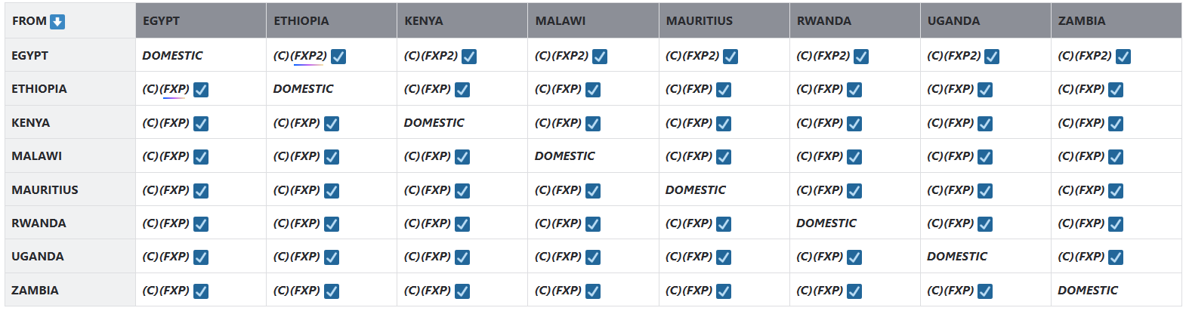
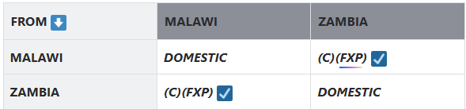
DRPP Status
Staging
Production
Notes:
INFITX Africa is a global team of Inclusive Financial Technology eXperts focused on building and supporting equitable and inclusive financial services that help alleviate poverty and gender inequality, and achieve the Sustainable Development Goals defined by the United Nations.

